Slide 1
Business Data Management Project
December 20, 2023
Under the Guidance of Professor Meng, Qu
Members:
Deviprasad Saka
Satya Shiva Sairam Kamma
Kalyan Venkat Mangipudi

Slide 2
Table of Contents
Overview
Project Scope
Dataset
ER Diagram
SQL Code Implementation
Useful Information Extraction
Accountability Contract
Tableau Visualizations
Conclusion

Slide 3
Overview
Our project focuses on the critical task of working with raw datasets and importing them into a SQL database. The primary objective is to empower decision-makers with valuable insights through the creation of an Entity-Relationship (ER) diagram and the development of SQL code for effective data extraction. We have also created visualization using the tool Tableau for gaining better insights about the data and presenting the results to the stakeholders.

Slide 4
Project Scope and Aim:
The aim of this project is to work with raw dataset and import them into the SQL Database for Informed managerial decisions. We have modeled a DVD rental store database, featuring things like films, actors, film-actor relationships, and a central inventory table that connects films, stores, and rentals.The scope of our project is defined by the need to transform raw data into actionable information. Our aim is to enable strategic decision-making by creating a robust ER diagram and implementing SQL code to extract meaningful insights from the datasets. For the sake of this project, we have leveraged the database MySQL to perform all kinds of database operations.

Slide 5
Raw Datasets
We worked with a DVD rental store dataset which is a centralized database, a collection of data with featuring things like films, actors, film-actor relationships. This data forms the foundation of our project, allowing us to derive valuable insights for managerial decision-making.

Slide 6
List of Tables in the Schema
Actor
Address
Category
City
Country
Customer
Film
Film_actor
Film_category
Film_text
Inventory
Language
Payment
Rental
Staff
store

Slide 7
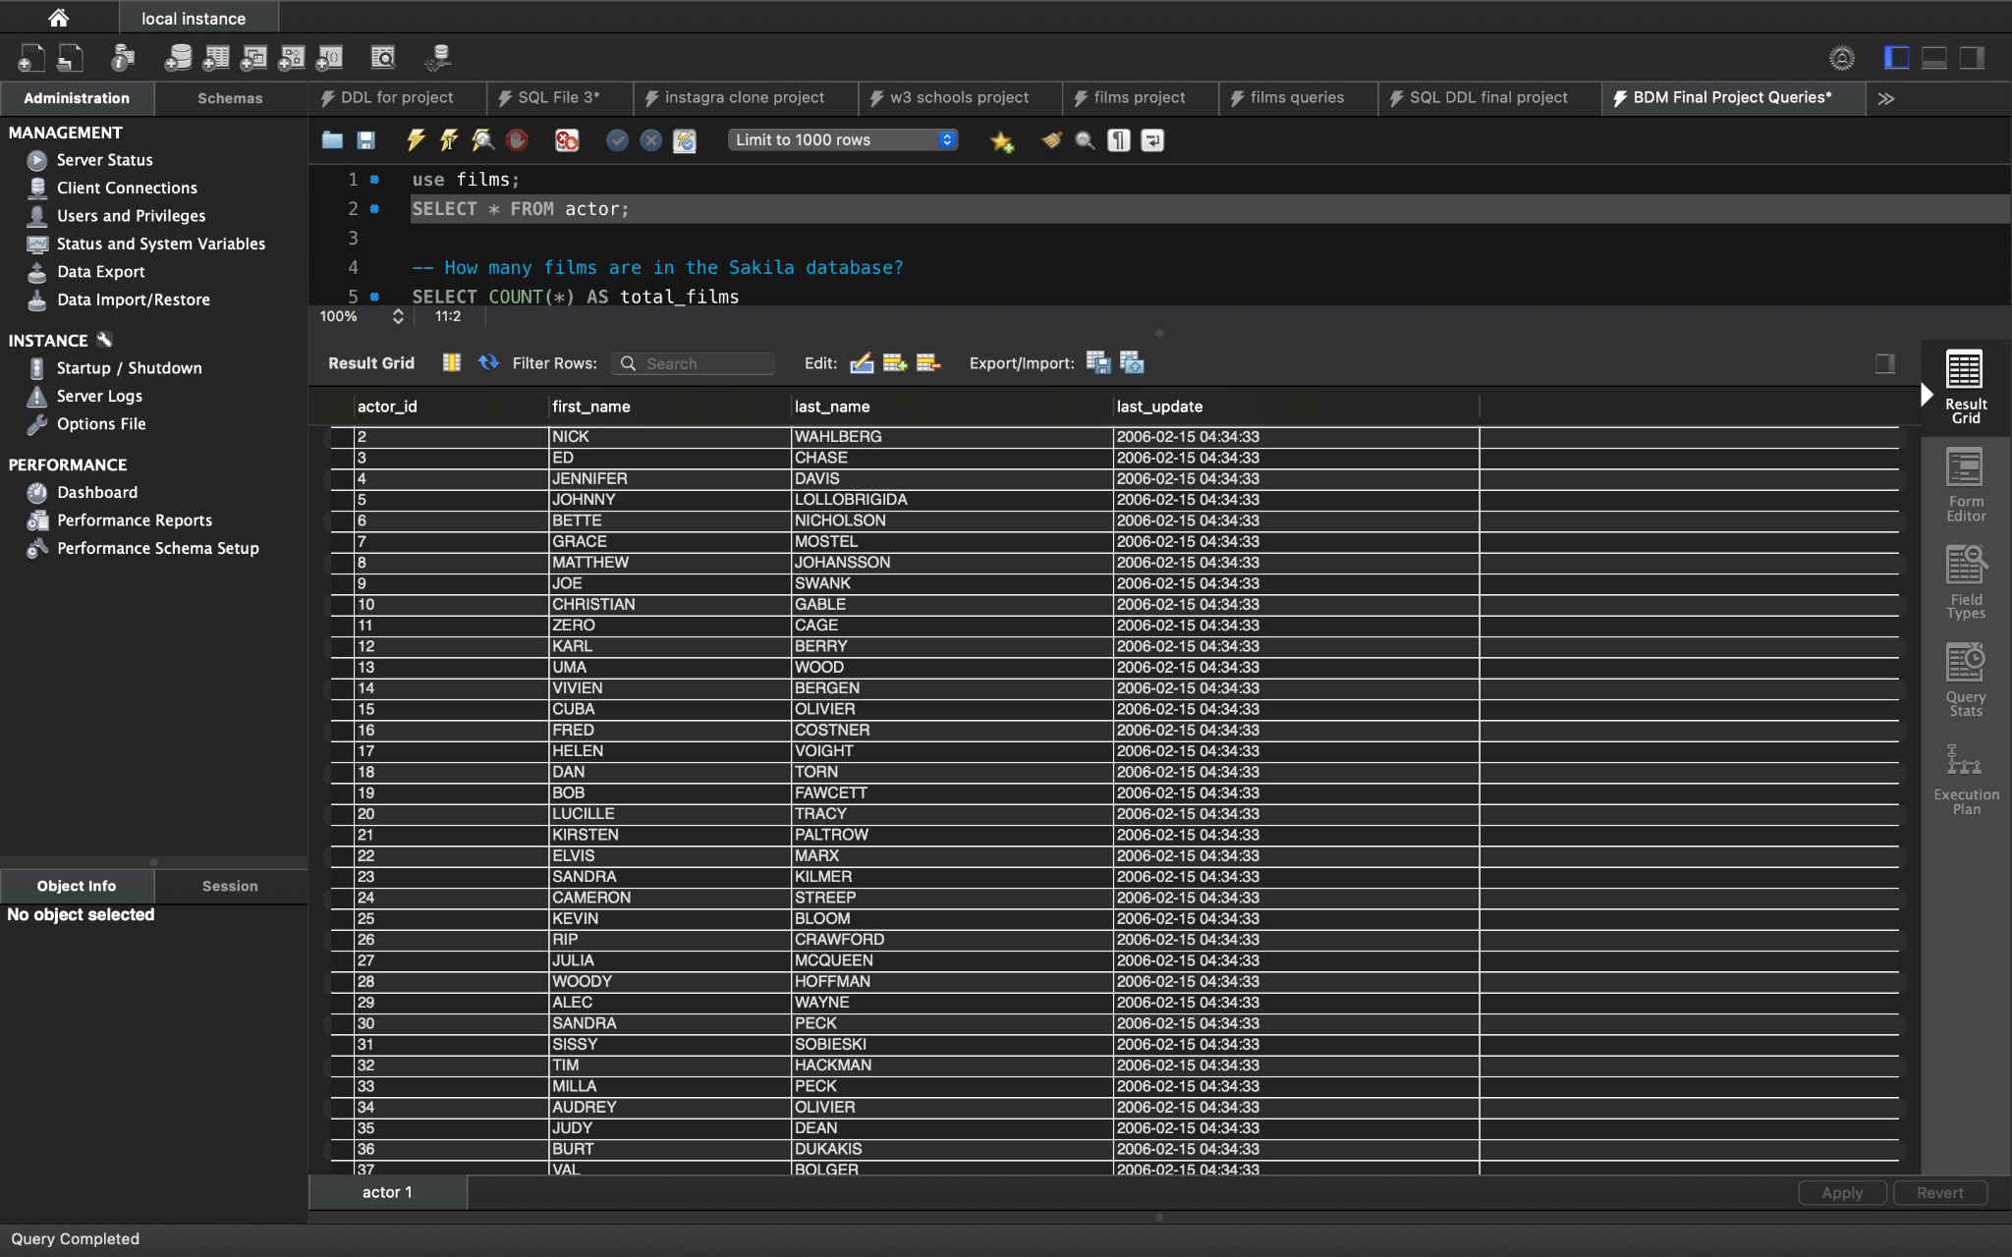
Example of Dataset
Retrieving data from the “actor” table

Slide 8
ER Diagram Creation
Our project began with the creation of a comprehensive Entity-Relationship (ER) diagram. This diagram visually represents the relationships between entities, their attributes, and the overall structure of the data. The key elements of the ER diagram include the tables, column names and nature of the relationship between entities. Also defined are the constraints on each table which help in maintaining database consistency and integrity.

Slide 9
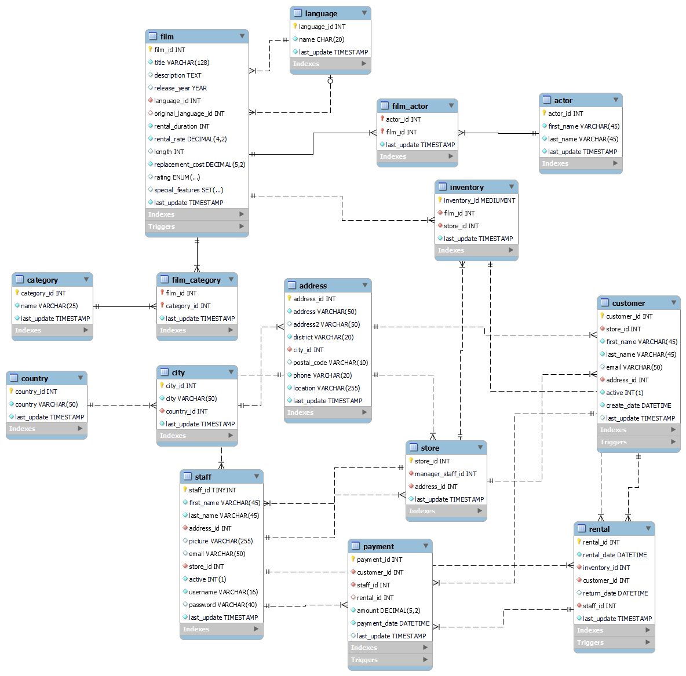
ER Diagram of the Data Model

Slide 10
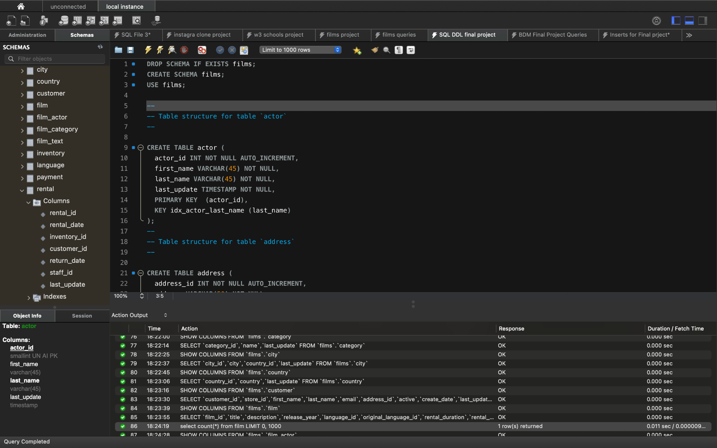
SQL Code Implementation
To operationalize our insights, we wrote SQL code to import the raw datasets into a SQL database. The code not only ensured efficient data storage but also laid the groundwork for subsequent extraction queries. At the same time, in order to reduce any inconsistency in the data, .csv files have been directly imported into the database for the creation of tables.
Example below shows the creation of schema in MySql database and creating first table named actors in the database.

Slide 11
Dataset Cleaning
Data cleaning is a crucial step in preparing raw datasets for our analysis, hence we have used some data cleaning techniques in SQL to check for any inconsistencies and correct them. Below mentioned are some of the data cleaning techniques that have operated on the data to clean the dataset.
1. Handling Missing Data
-- 'length' column in 'film' table has missing values. Update missing values with the average length.
UPDATE film
SET length = COALESCE(length, (SELECT AVG(length) FROM film WHERE length IS NOT NULL));
2. 'last_update' column in 'actor' table has missing values. Update missing values with the current timestamp.
UPDATE actor
SET last_update = COALESCE(last_update, CURRENT_TIMESTAMP);
3. Deduplication
-- Remove duplicate actors based on 'first_name' and 'last_name'
DELETE FROM actor
WHERE actor_id NOT IN (
SELECT MAX(actor_id)
FROM actor
GROUP BY first_name, last_name
);

Slide 12
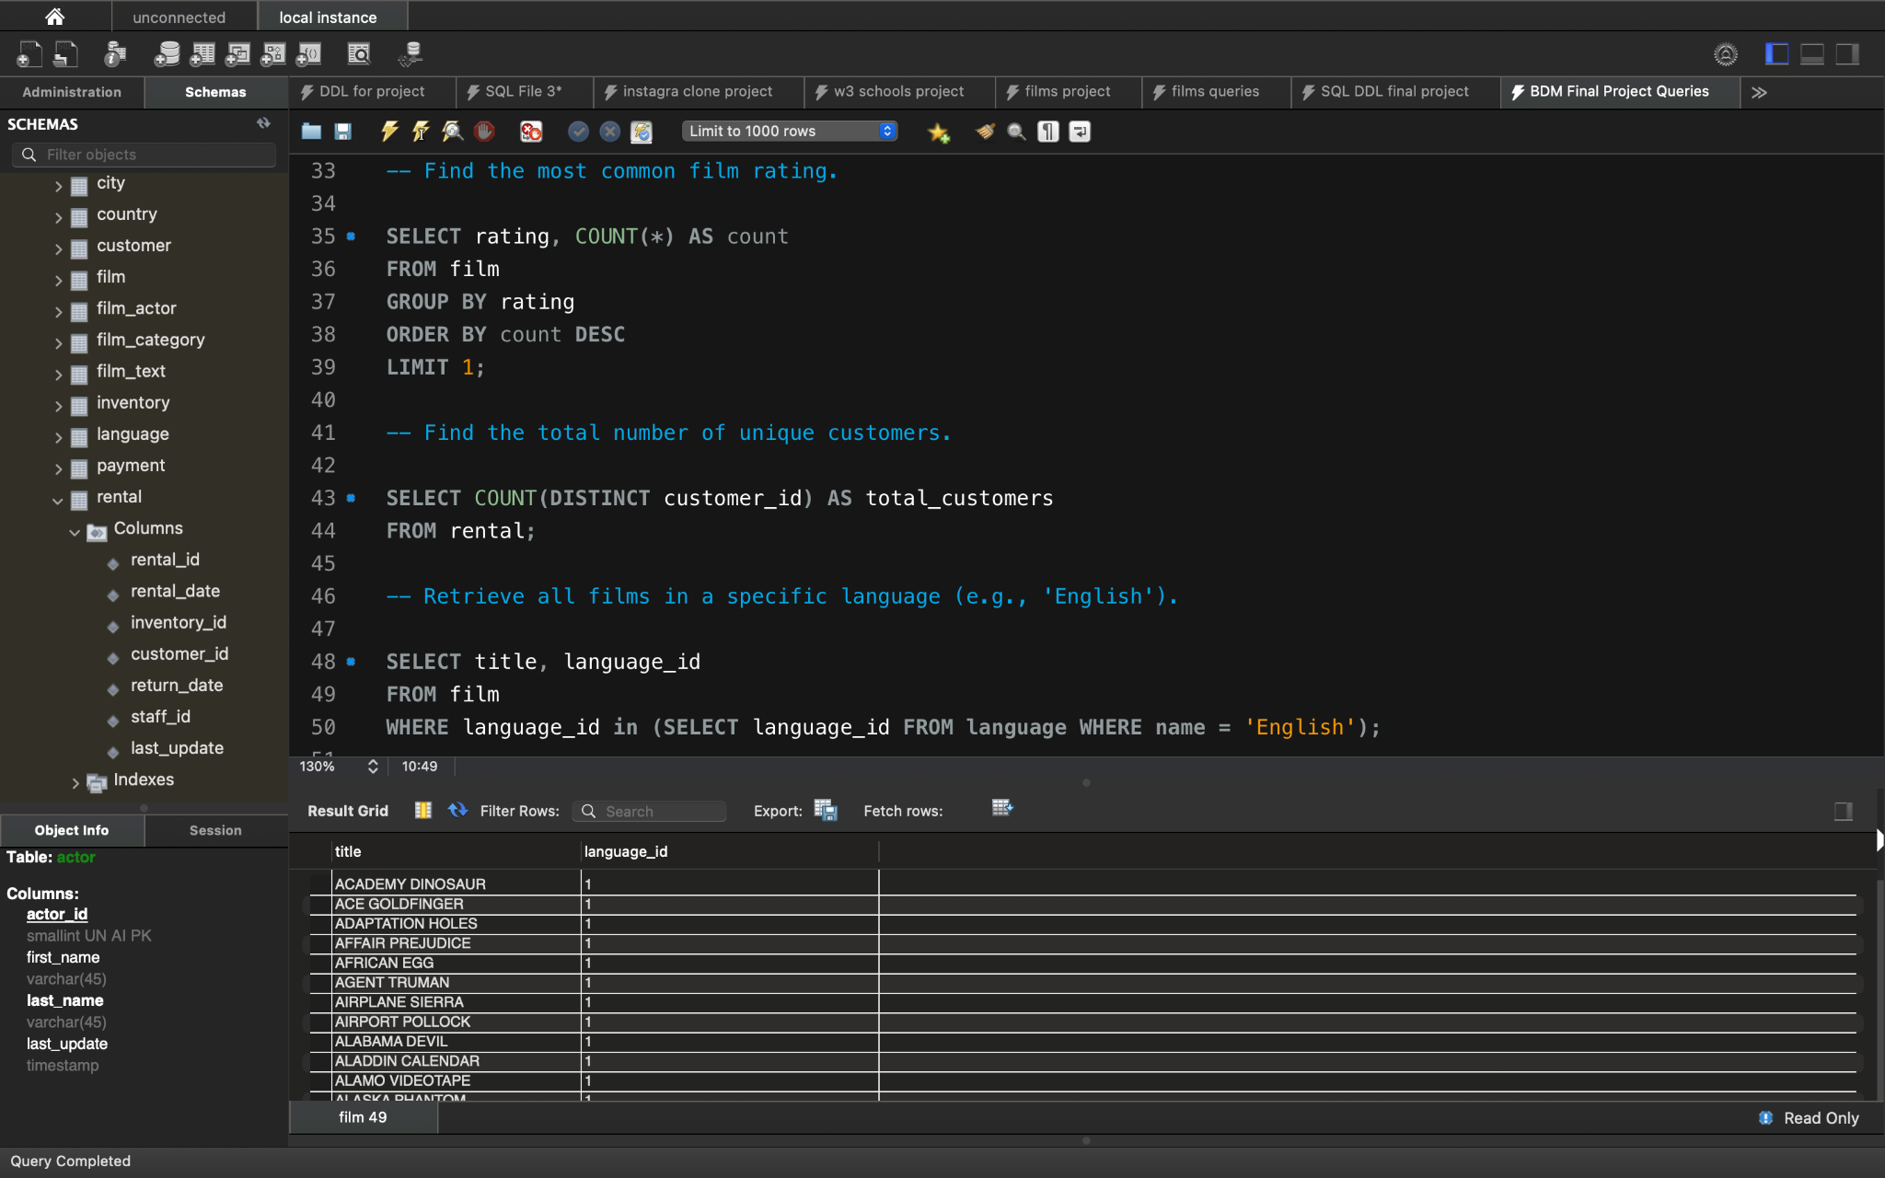
Useful Information Extraction
Through strategic SQL queries, we extracted useful information from the database. Our focus was on generating insights that directly contribute to informed managerial decision-making. For example, we wanted to retrieve all films in a specific language (i.e., English). We can write a query for the same using the required tables and obtain results for making decisions.

Slide 13
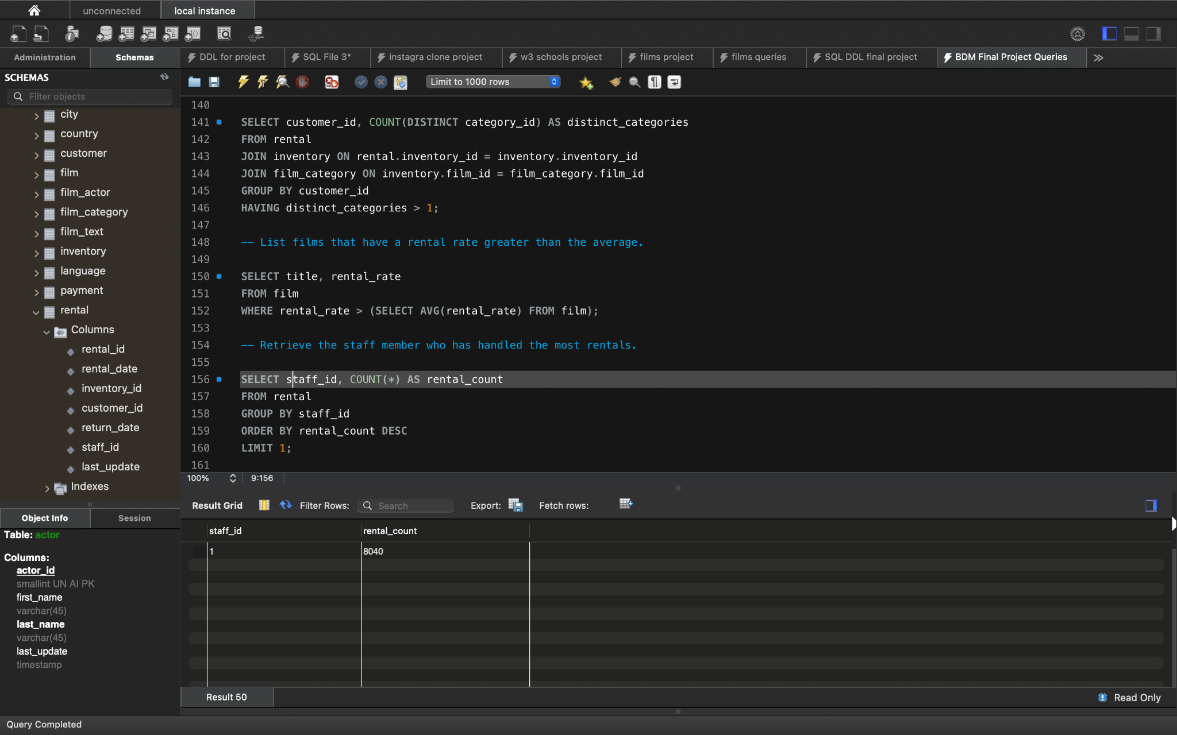
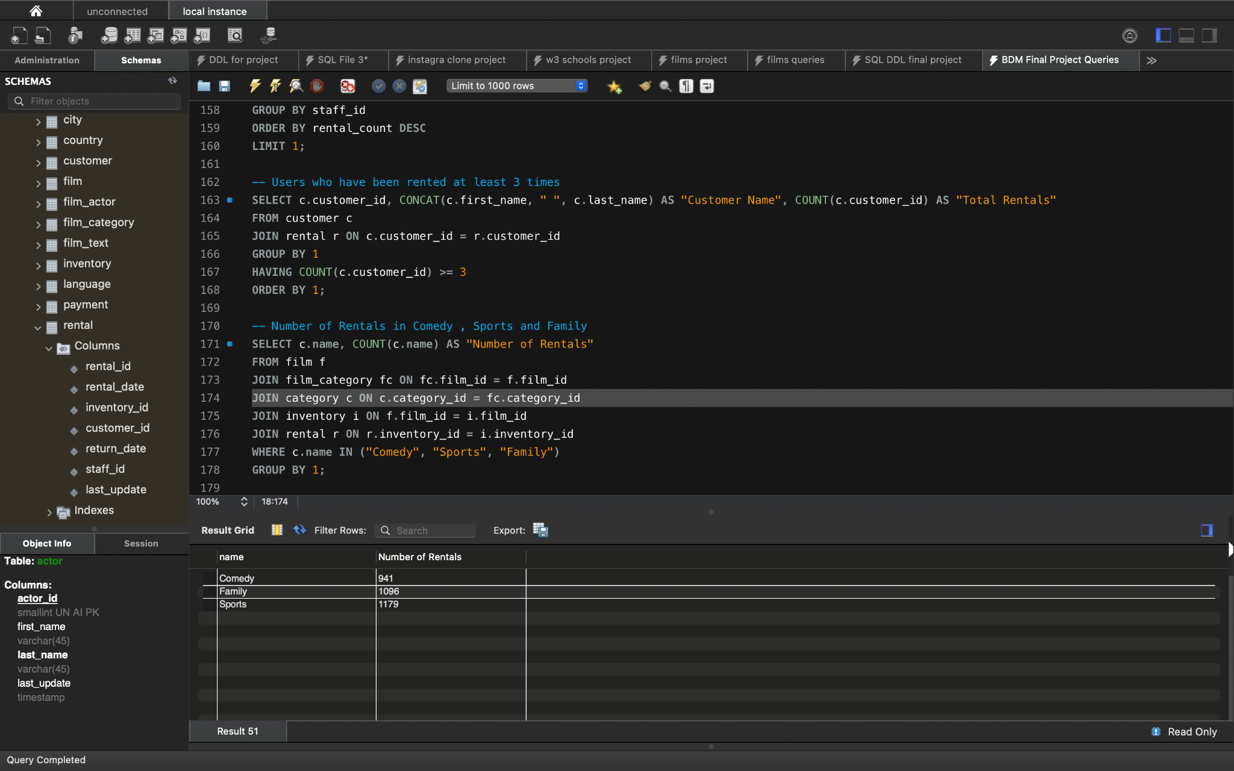
SQL Queries
Retrieve the staff member who has handled the most rentals.
Number of Rentals in Comedy , Sports and Family

Slide 14
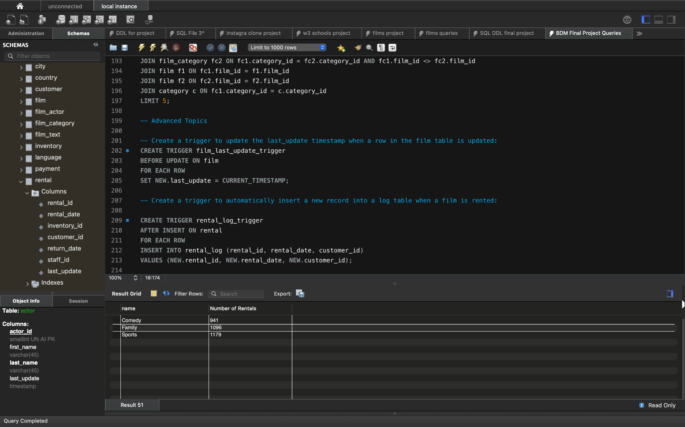
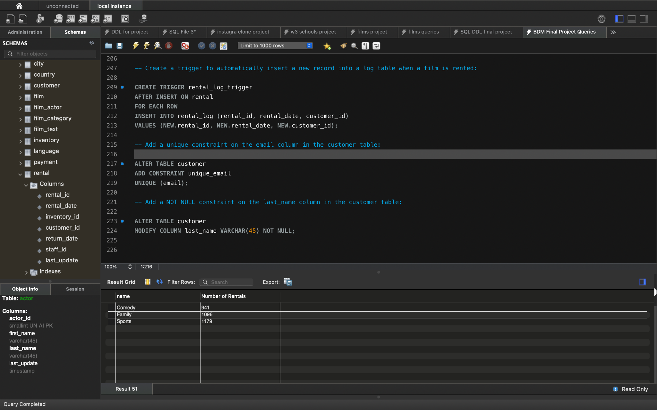
Creating Advanced SQL Objects
Creating Triggers on the Database
Creating Constraints on the Tables

Slide 15
Accountability Contract
To keep our project on track, we established an accountability contract. This contract served as our guide, outlining tasks, responsibilities, and deadlines. It played a crucial role in maintaining team organization and meeting project milestones.
25

Slide 16
Work Breakdown | Group Member | Group Member | Group Member
Search and create datasets | Sairam | Deviprasad | Kalyan Venkat
ER Diagram | Sairam
Create SQL code and import datasets to database | Kalyan Venkat
Dataset cleaning with SQL Code | Deviprasad
Design your own SQL question and write SQL queries | Sairam | Deviprasad | Kalyan Venkat
Presentation | Deviprasad
Visualizations | Sairam
PDF Report | Kalyan Venkat

Slide 17
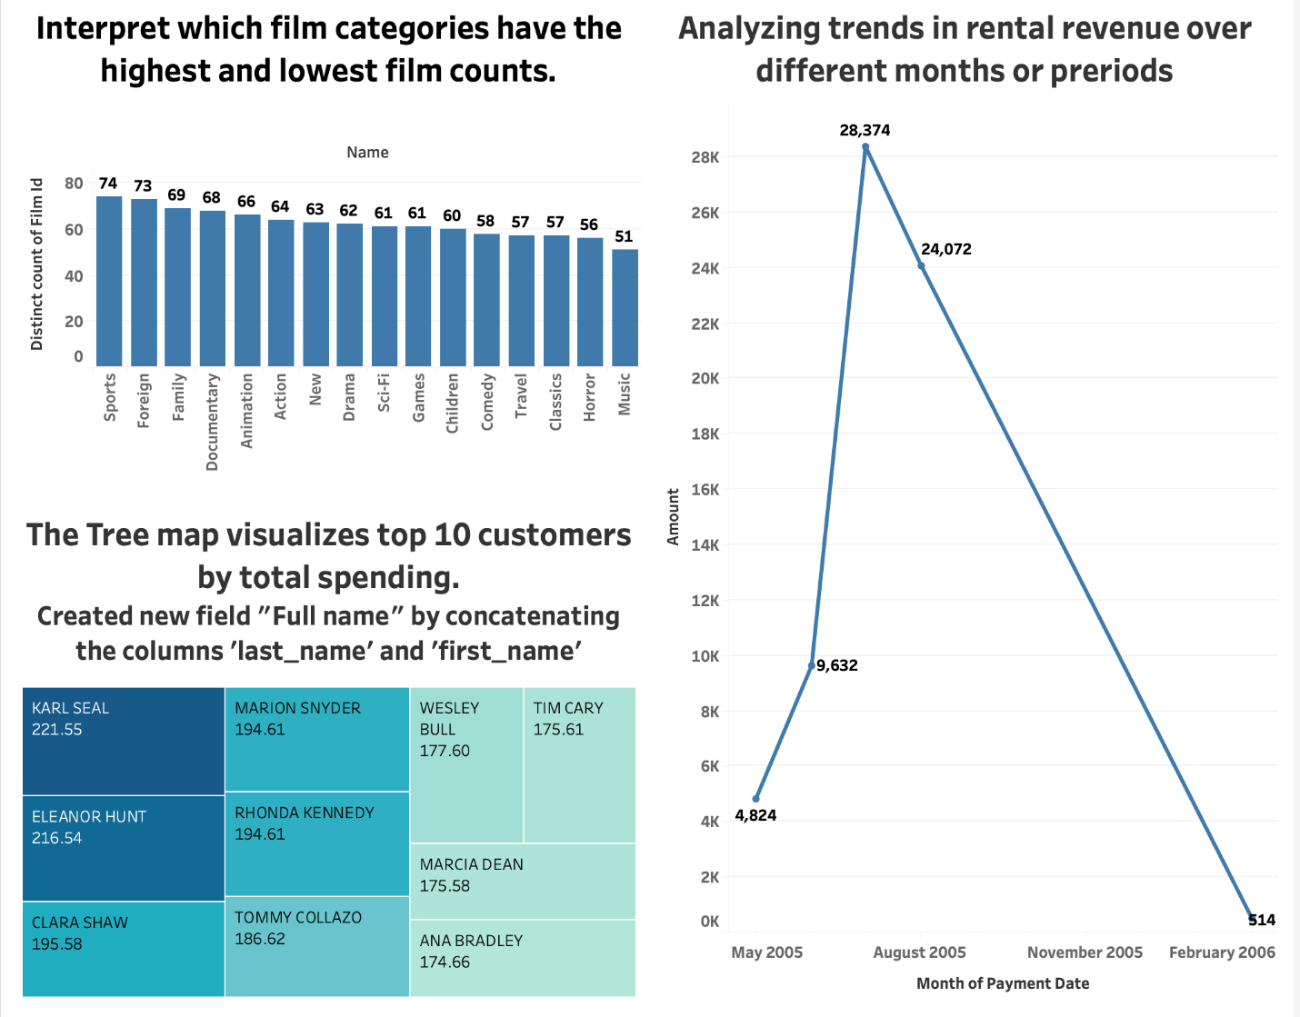
Tableau Visualizations
This visual representation encapsulates our final goal – the synthesis of raw data into actionable insights. The outcomes of our project align seamlessly with this depiction, showcasing the transformative power of data.

Slide 18
Conclusion
In conclusion, our project marks a significant achievement in harnessing the potential of raw datasets. The ER diagram and SQL code we developed lay the foundation for ongoing data-driven decision-making. The insights derived from the data hold the promise of positively impacting managerial strategies.

Slide 19
Thank you!

